Slide 1

The Practice of Statistics for Business and Economics Third Edition
David S. Moore
George P. McCabe
Layth C. Alwan
Bruce A. Craig
William M. Duckworth
© 2011 W.H. Freeman and Company

Slide 2
Announcement
Wednesday (Jan 9) – Meet in classroom, not lab
Buy a textbook with StatsPortal access card
Important Websites:
StatsPortal:
http://courses.bfwpub.com/psbe3e.php
Homework assignments
E-book and many great learning tools
Please register using your access code
Blackboard Learn:
mycourses.purdue.edu: lab assignments, grades
Piazza:
piazza.com: discussion forums
Free. Please register ASAP

Slide 3
Examining Distributions Displaying Distributions with Graphs
PSBE Chapter 1.1
© 2011 W.H. Freeman and Company

Slide 4
Objectives (PSBE Chapter 1.1)
Displaying distributions with graphs
Types of variables
Ways to chart categorical data
Bar graphs
Pie charts
Ways to chart quantitative data
Histograms
Interpreting histograms
Stemplots
Stemplots versus histograms
Time plots

Slide 5
Important terms
Cases: The objects described by a set of data.
Ex: customers, cities, patients, cars
Variable: A characteristic of a case.
Ex: profit, duration of a service call, number of customers, gender
Different cases can have different values for the variables.
Distribution of a variable: the values the variable takes and how often it takes them.

Slide 6
Law firm example
A law firm studies the gender of their clients. They find 55% are males and 45% are females.
Cases: Clients
Variable: Gender
Distribution:
Values: Male, Female
How often: 55% and 45%, respectively

Slide 7
Types of variables
Quantitative Variable:
Takes numerical values for which we can do arithmetic
Ex: age, credit card balance, number of employees, time until customer is served
Categorical Variable:
Places a case into one of several groups or categories
Ex: gender, brand of credit card, own a home (yes/no)

Slide 8
Credit card example
A credit card company studies the spending behavior of their 21- to 25- year-old customers with a $1000 credit limit. They randomly select 100 of them and record the following for each person:
Average balance on their card over the last year
Whether customer has ever made late payments
Which day of the week their card is used the most
Customer’s age (in years)
For each item above:
Identify the type of variable
Give its possible values

Slide 9
Credit card example
For each item: Identify the type of variable and give its possible values.
Average balance on their card over the last year
Quantitative: $0.00 through $1000.00
Whether customer has ever made late payments
Categorical: Yes, No
Which day of the week their card is used the most
Categorical: Sunday, Monday, Tuesday, …, Saturday
Customer’s age (in years)
Quantitative: 21, 22, 23, 24, 25 years

Slide 10
To better understand a data set, ask:
Who?
What cases do the data describe?
How many cases?
What?
How many variables?
What is the exact definition of each variable?
What is the unit of measurement for each variable?
Why?
What is the purpose of the data?
What questions are being asked?
Are the variables suitable?

Slide 11
Displaying categorical data
Purpose:
Summarize the data so the reader can grasp the distribution quickly
Process:
List the categories
Give either the count or the percent of cases that fall into each category
Methods:
Tables, Pie Charts, Bar Graphs

Slide 12
Marital status example
Marital status
Females 15 and up
Data summarized in table form
Marital status | Count (Millions)
Married | 116
Never married | 44
Divorced | 19
Widowed | 16
Total | 195

Slide 13
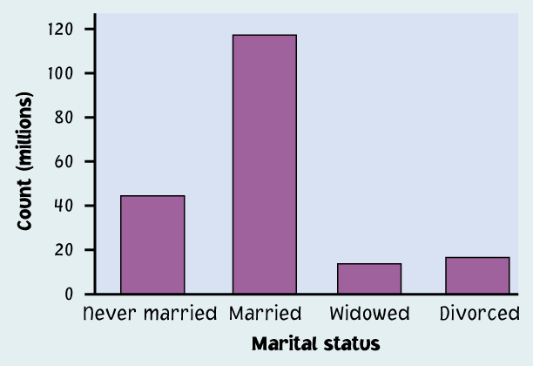
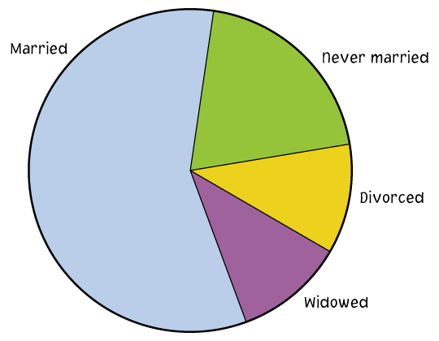
Ways to chart categorical data
Because the variable is categorical, the data in the graph can be ordered any way we want (alphabetical, by increasing value, by year, by personal preference, etc.).
Bar graphs Each category is represented by a bar.
Pie charts The slices must represent the parts of one whole.

Slide 14
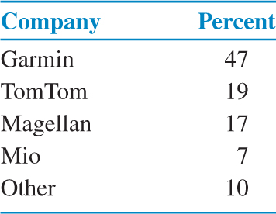
Example 1.7 GPS Market share example

Slide 15
Bar graphs
Each category is represented by one bar. The bar’s height shows the count (or sometimes the percentage) for that particular category.

Slide 16
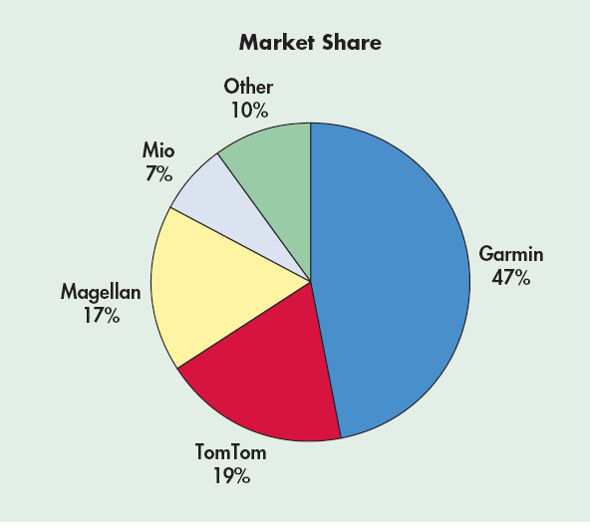
Pie charts
Each slice represents a piece of one whole. The size of a slice depends on what
percent of the whole this category represents.

Slide 17
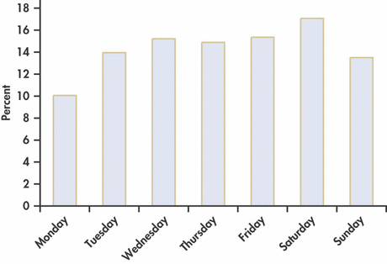
Example 1.10 The Cost Is $164 Billion!
Auto accidents cost $164 billion each year.³ How can this enormous burden on the economy be reduced? Let’s look at some data. is a bar graph that gives the percents of auto accidents for each day of the week. What do we learn from this graph?

Slide 18
Accidents per day of the week
Bar graph sorted by rank (Pareto Chart)
→ Easy to analyze
Sorted chronologically
→ Much less useful

Slide 19
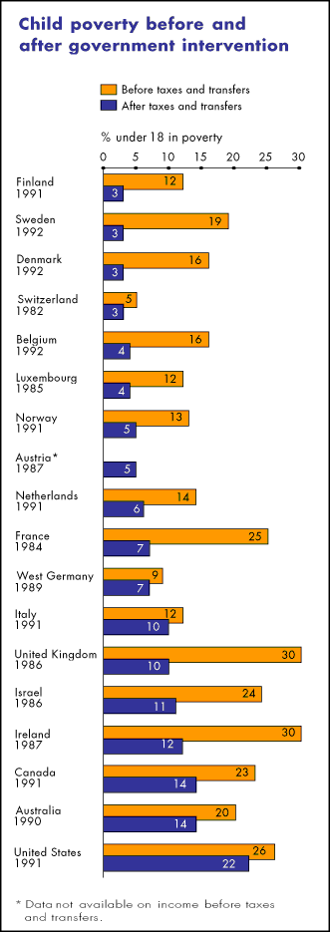
Child poverty before and after government intervention—UNICEF, 1996
What does this chart tell you?
The United States has the highest rate of child poverty among developed nations (22% of under 18).
Its government does the least—through taxes and subsidies—to remedy the problem (size of orange bars and percent difference between orange/blue bars).
Could you transform this bar graph to fit in one pie chart? In two pie charts? Why?
The poverty line is defined as 50% of national median income.

Slide 20
Ways to chart quantitative data
Histograms and stemplots
These are summary graphs for a single variable. They are very useful to understand the pattern of variability in the data.
Line graphs: time plots
Use when there is a meaningful sequence, like time. The line connecting the points helps emphasize any change over time.

Slide 21
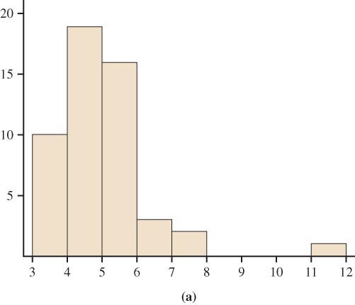
Histograms
The range of values that a variable can take is divided into equal size intervals.
The histogram shows the number of individual data points that fall in each interval.
Example: Histogram of the December 2004 unemployment rates in the 50 states and Puerto Rico.

Slide 22
Case 1.1 Treasury Bills
Treasury bills, also known as T-bills, are bonds issued by the U.S. Department of the Treasury. You buy them at a discount from their face value, and they mature in a fixed period of time.
For example, you might buy a $1000 T-bill for $980. When it matures, six months later, you would receive $1000—your original $980 investment plus $20 interest. This interest rate is $20 divided by $980, which is 2.04% for six months. Interest is usually reported as a rate per year, so for this example the interest rate would be 4.08%.
Rates are determined by an auction that is held every four weeks. The data set contains the interest rates for T-bills for each auction from December 12, 1958, to October 3, 2008.⁸
Our data set contains 2600 cases. The two variables in the data set are the date of the auction and the interest rate. To learn something about T-bill interest rates, we begin with a histogram.

Slide 23
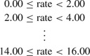
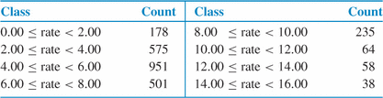
Example 1.12 A Histogram of T-bill Interest Rates
Step 1. Divide the range of the interest rates into classes of equal width. The T-bill interest rates range from 0.85% to 15.76%, so we choose as our classes
Step 2. Count the number of cases in each class. Here are the counts:
Step 3. Draw the histogram.

Slide 24
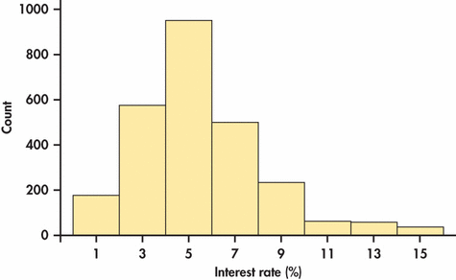
Example 1.12 A Histogram of T-bill Interest Rates

Slide 25
Interpreting histograms
When describing the distribution of a quantitative variable, we look for the overall pattern and for striking deviations from that pattern. We can describe the overall pattern of a histogram by its shape, center, and spread.
Histogram with a line connecting each column → too detailed
Histogram with a smoothed curve highlighting the overall pattern of the distribution

Slide 26
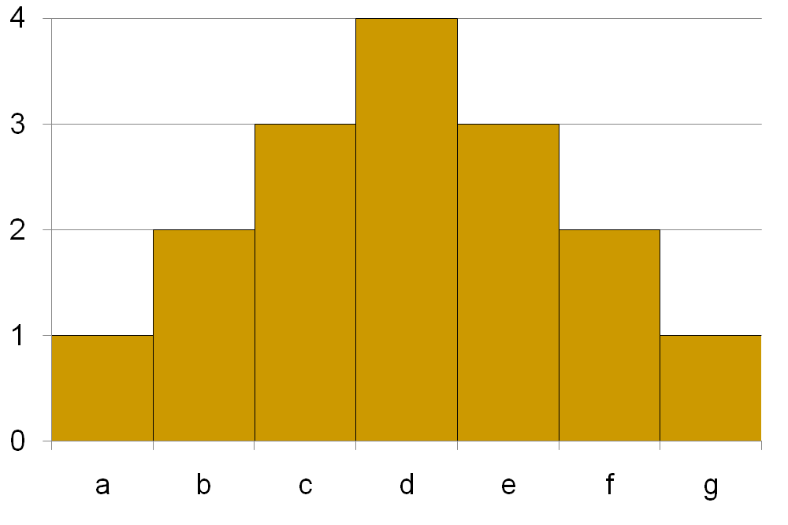
Common distribution patterns (shapes)
Symmetric
Left and right sides are mirror images of each other (or close).

Slide 27
Common distribution patterns (shapes)
Skewed left
Left side extends farther out than the right side.

Slide 28
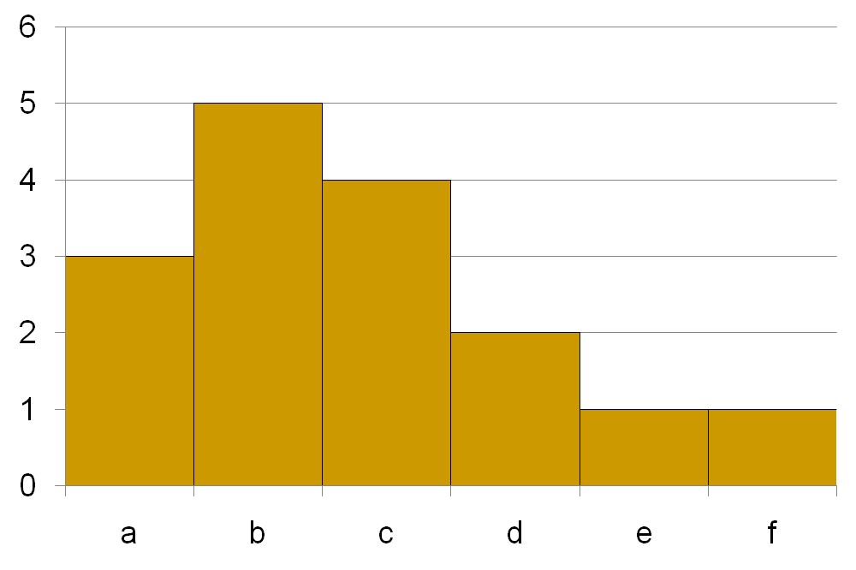
Common distribution patterns (shapes)
Skewed right
Right side extends farther out than the left side.

Slide 29
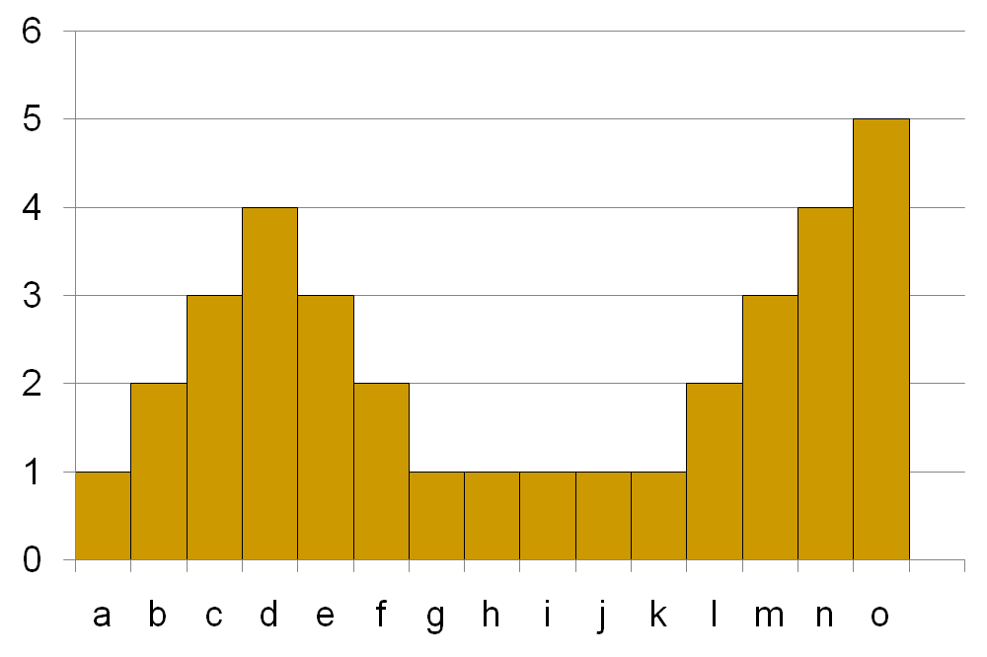
Many shapes are complex
Two peaks
First part symmetric; flat in the middle; increasing at the end

Slide 30
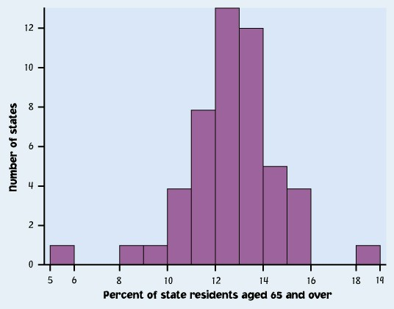
Outliers
An important kind of deviation is an outlier. Outliers are observations that lie outside the overall pattern of a distribution. Always look for outliers and try to explain them.
The overall pattern is fairly symmetrical except for two states clearly not belonging to the main trend. Alaska and Florida have unusual representation of the elderly in their population.
A large gap in the distribution is typically a sign of an outlier.
Alaska
Florida

Slide 31
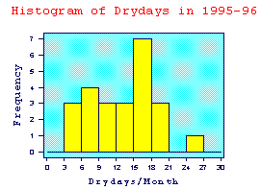
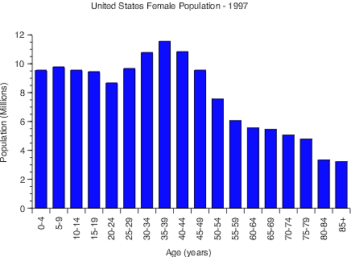
IMPORTANT NOTE: Your data are the way they are. Do not try to force them into a particular shape.
Histogram of dry days in 1995
It is a common misconception that if you have a large enough data set, the data will eventually turn out nice and symmetrical.

Slide 32
How to create a histogram
It is an iterative process – try and try again.
What bin size should you use?
Not too many bins with either 0 or 1 counts
Not overly summarized that you loose all the information
Not so detailed that it is no longer summary
➔ rule of thumb: start with 5 to10 bins
Look at the distribution and refine your bins
(There isn’t a unique or “perfect” solution)

Slide 33
Example 1.13 Calls to a Customer Service Center
Many businesses operate call centers to serve customers who want to place an order or make an inquiry.
Customers want their requests handled thoroughly.
Businesses want to treat customers well, but they also want to avoid wasted time on the phone.
They therefore monitor the length of calls and encourage their representatives to keep calls short.

Slide 34
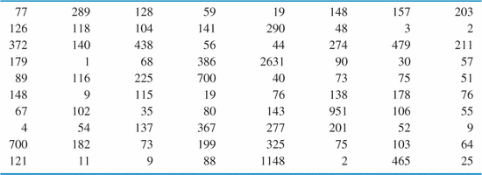
Example 1.13 Calls to a Customer Service Center
We have data on the length of all 31,492 calls made to the customer service center of a small bank in a month. Table 1.1 displays the lengths of the first 80 calls.
TABLE 1.1 Service times (seconds) for calls to a customer service center

Slide 35
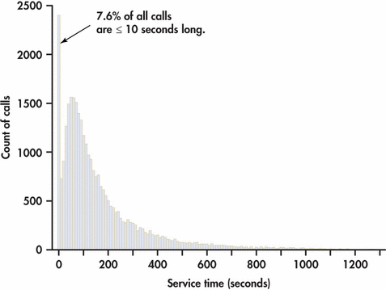
Example 1.14 A histograms of the lengths of all 31,492 calls

Slide 36
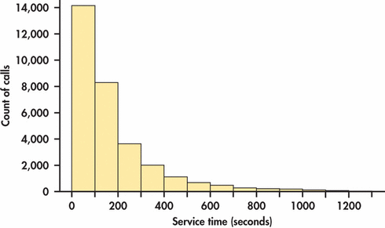
Example 1.15 Another histograms of the lengths of all 31,492 calls

Slide 37
Stemplot
Purpose
Alternative display for quantitative data
Works well for small data sets – quick and easy
Gives more info than a histogram: can see the data values
Method
Group data by 10s, 100s, 1000s, etc.
Instead of bars, make rows of data for each group
Form groups using leading digit(s)
Stack data in each group using the final digit for each value

Slide 38
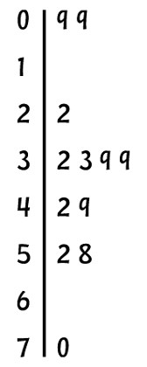
Stemplots
How to make a stemplot:
Example: 12 data values 9, 9, 22, 32, 33, 39, 39, 42, 49, 52, 58, 70
Separate each observation into a stem, consisting of all but the final (right-most) digit, and a leaf, which is that remaining final digit. Stems may have as many digits as needed, but each leaf contains only a single digit.
Write the stems in a vertical column with the smallest value at the top, and draw a vertical line at the right of this column.
Write each leaf in the row to the right of its stem, in increasing order out from the stem.
STEM
LEAVES

Slide 39
Example 1.12 A Histogram of T-bill Interest Rates

Slide 40
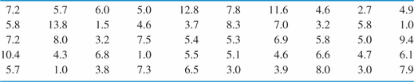
Example 1.16 Stemplots of the T-bill interest rates
The histogram that we produced earlier to examine the T-bill interest rates used all 2600 cases in the data set. To illustrate the idea of a stemplot, we will take a simple random sample of size 50 from this data set. We will learn more about how to take such samples in Chapter 3. Here are the data:

Slide 41
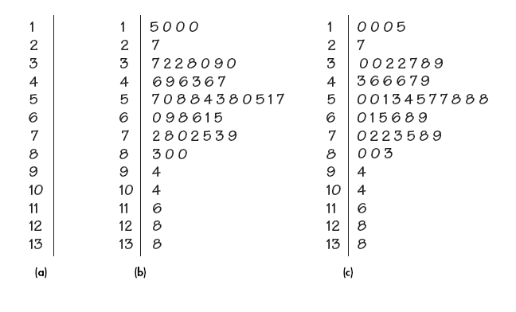
Stemplots
Stemplots of the T-bill interest rates

Slide 42
Stemplot
Stemplots do not work well for large datasets.
When the observed values have too many digits, trim the numbers before making a stemplot.
When plotting a moderate number of observations, you can split each stem.

Slide 43
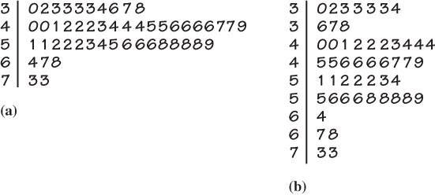
Stemplot
Stemplots of the December 2004 unemployment rates in the 50 states.
(b) uses split stems.

Slide 44
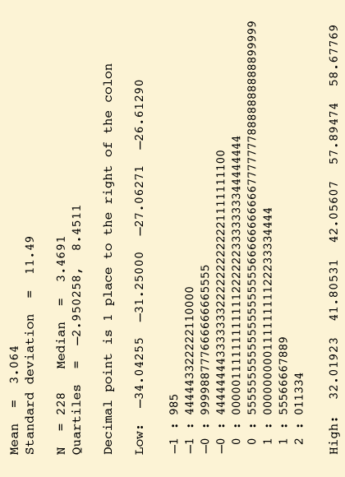
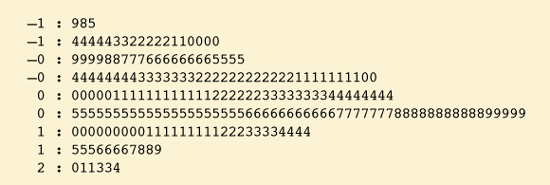
Stemplots vs. histograms
Stemplots are quick and dirty histograms that can easily be done by hand, therefore very convenient for back of the envelope calculations. However, they are rarely found in scientific or laymen publications.

Slide 45
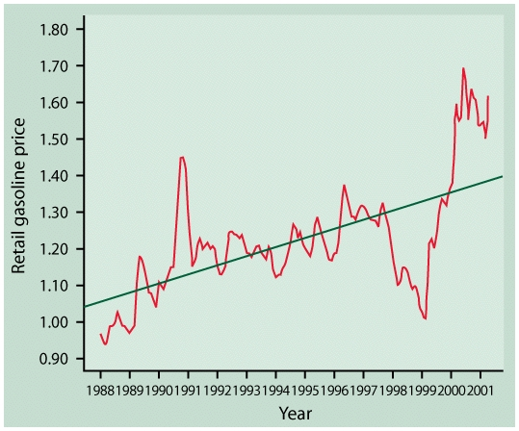
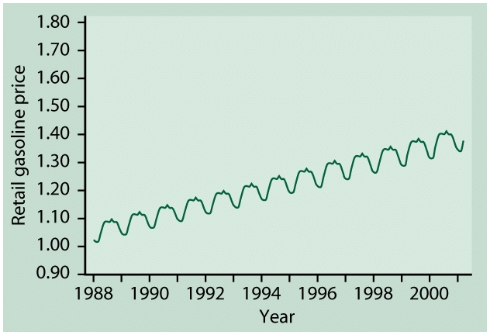
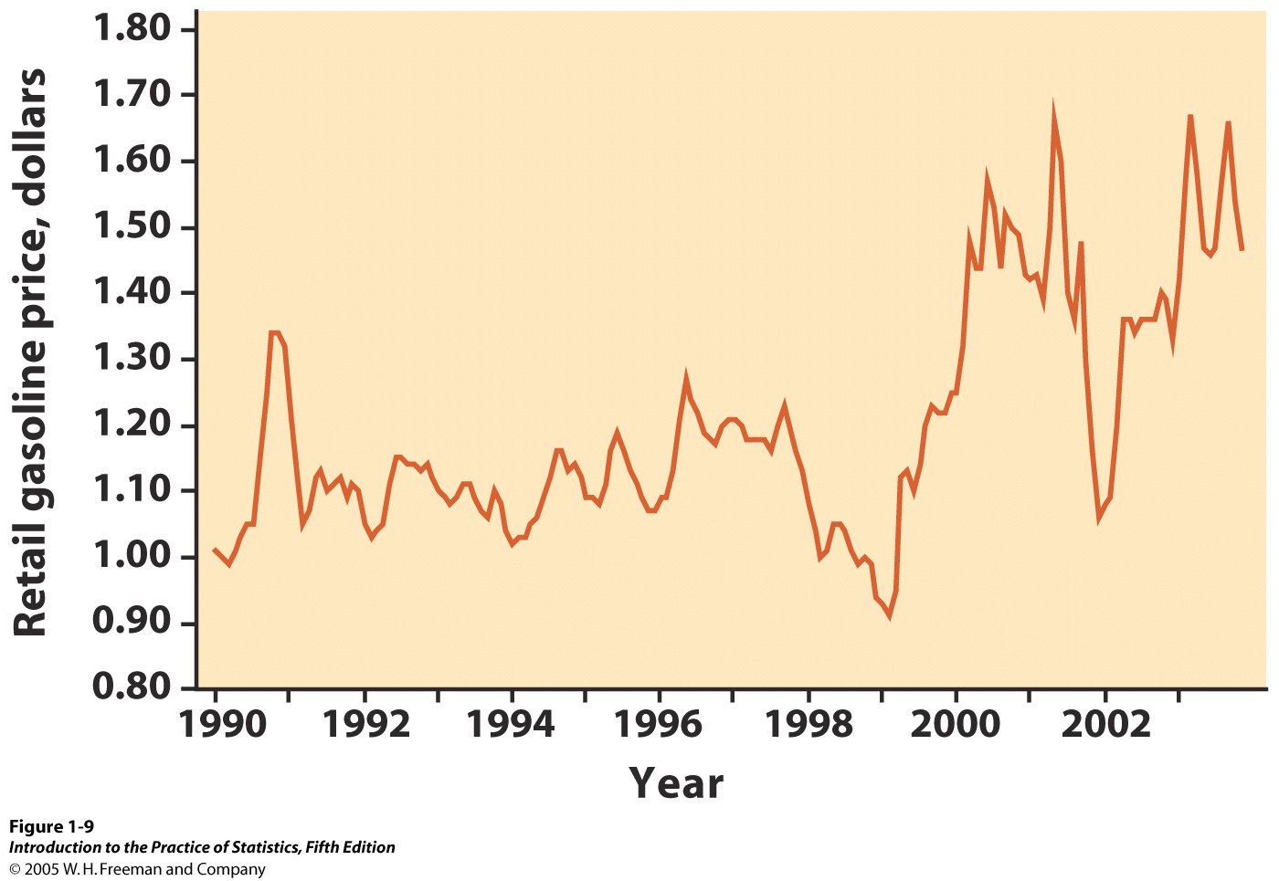
Line graphs: time plots
In a time plot, time always goes on the horizontal, x axis.
We describe time series by looking for an overall pattern and for striking deviations from that pattern. In a time series:
A trend is a rise or fall that persists over time, despite small irregularities.
A pattern that repeats itself at regular intervals of time is called seasonal variation.

Slide 46
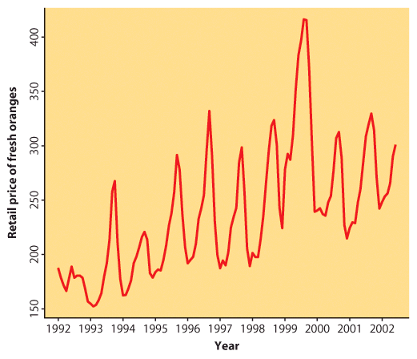

Line graphs: time plots
Retail price of fresh oranges over time
Time is on the horizontal, x axis.
The variable of interest—here “retail price of fresh oranges”— goes on the vertical, y axis.
This time plot shows a regular pattern of yearly variations. These are seasonal variations in fresh orange pricing most likely due to similar seasonal variations in the production of fresh oranges.
There is also an overall upward trend in pricing over time. It could simply be reflecting inflation trends or a more fundamental change in this industry.

Slide 47
Line graphs: time plots
T-bill interest rates
Time is on the horizontal, x axis.
The variable of interest—here “T-bill interest rate”— goes on the vertical, y axis.
This time plot shows that there is much more to this data than shown in the histogram.

Slide 48
Scales matter
How you stretch the axes and choose your scales can give a different impression.
A picture is worth a thousand words,
BUT There is nothing like hard numbers. → Look at the scales.

Slide 49
Examining Distributions Describing Distributions with Numbers
PSBE Chapter 1.2
© 2011 W.H. Freeman and Company

Slide 50
Objectives (PSBE Chapter 1.2)
Describing distributions with numbers
Measures of center: mean, median
Comparing mean and median
Measures of spread: quartiles, standard deviation
Five-number summary and boxplots
Choosing measures of center and spread

Slide 51
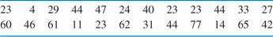
Case 1.2 Time to Start a Business
An entrepreneur faces many bureaucratic and legal hurdles when starting a new business. The World Bank collects information about starting businesses throughout the world. It has determined the time, in days, to complete all of the procedures required to start a business. Data for 195 countries are included in the data set. For this section we will examine data for a sample of 24 of these countries. Here are the data:

Slide 52
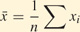
Measure of center: the mean
The mean or arithmetic average
To calculate the average, or mean, add all values, then divide by the number of individuals. It is the “center of mass.”
Sum of start times is 897
divided by 24 businesses = 37.375 days

Slide 53
Measure of center: the median
The median is the midpoint of a distribution—the number such that half of the observations are smaller and half are larger.
1. Sort observations by size.
n = number of observations
______________________________
2.a. If n is odd, the median is observation (n+1)/2 down the list.
⬅ n = 25
(n+1)/2 = 26/2 = 13
Median = 3.4
2.b. If n is even, the median is the mean of the two middle observations.
n = 24 ➔
n/2 = 12
Median = (3.3+3.4) /2 = 3.35

Slide 54
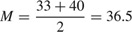
Example 1.22 Median Time to Start a Business
To find the median time to start a business for our 24 countries, we first arrange the data in order from smallest to largest:

Slide 55
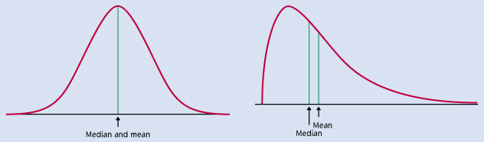
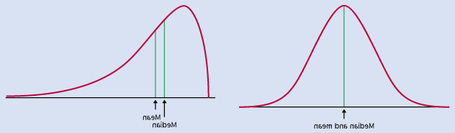
Comparing the mean and the median
The mean and the median are the same only if the distribution is symmetrical. The median is a measure of center that is resistant to skew and outliers. The mean is not.
Mean and median for a symmetric distribution
Mean
Median
Mean and median for skewed distributions
Left skew
Mean
Median
Right skew
Mean
Median

Slide 56
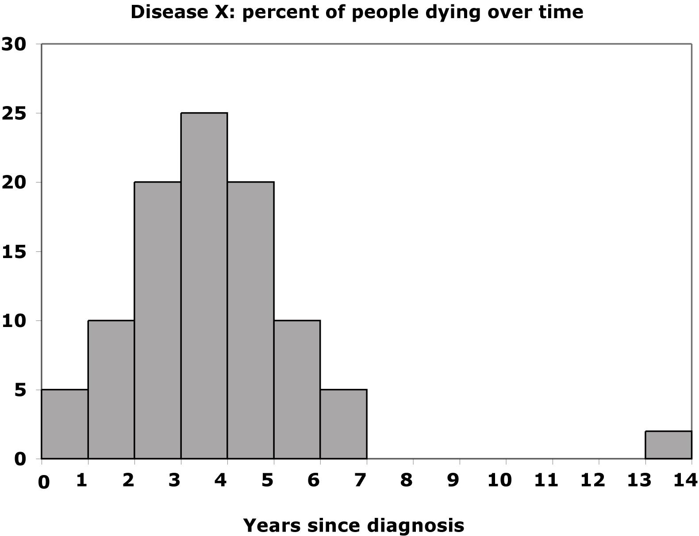
Mean and median of a distribution with outliers
Without the outliers
Percent of people dying
With the outliers
The mean is pulled to the right a lot by the outliers (from 3.4 to 4.2).
The median, on the other hand, is only slightly pulled to the right by the outliers (from 3.4 to 3.6).

Slide 57
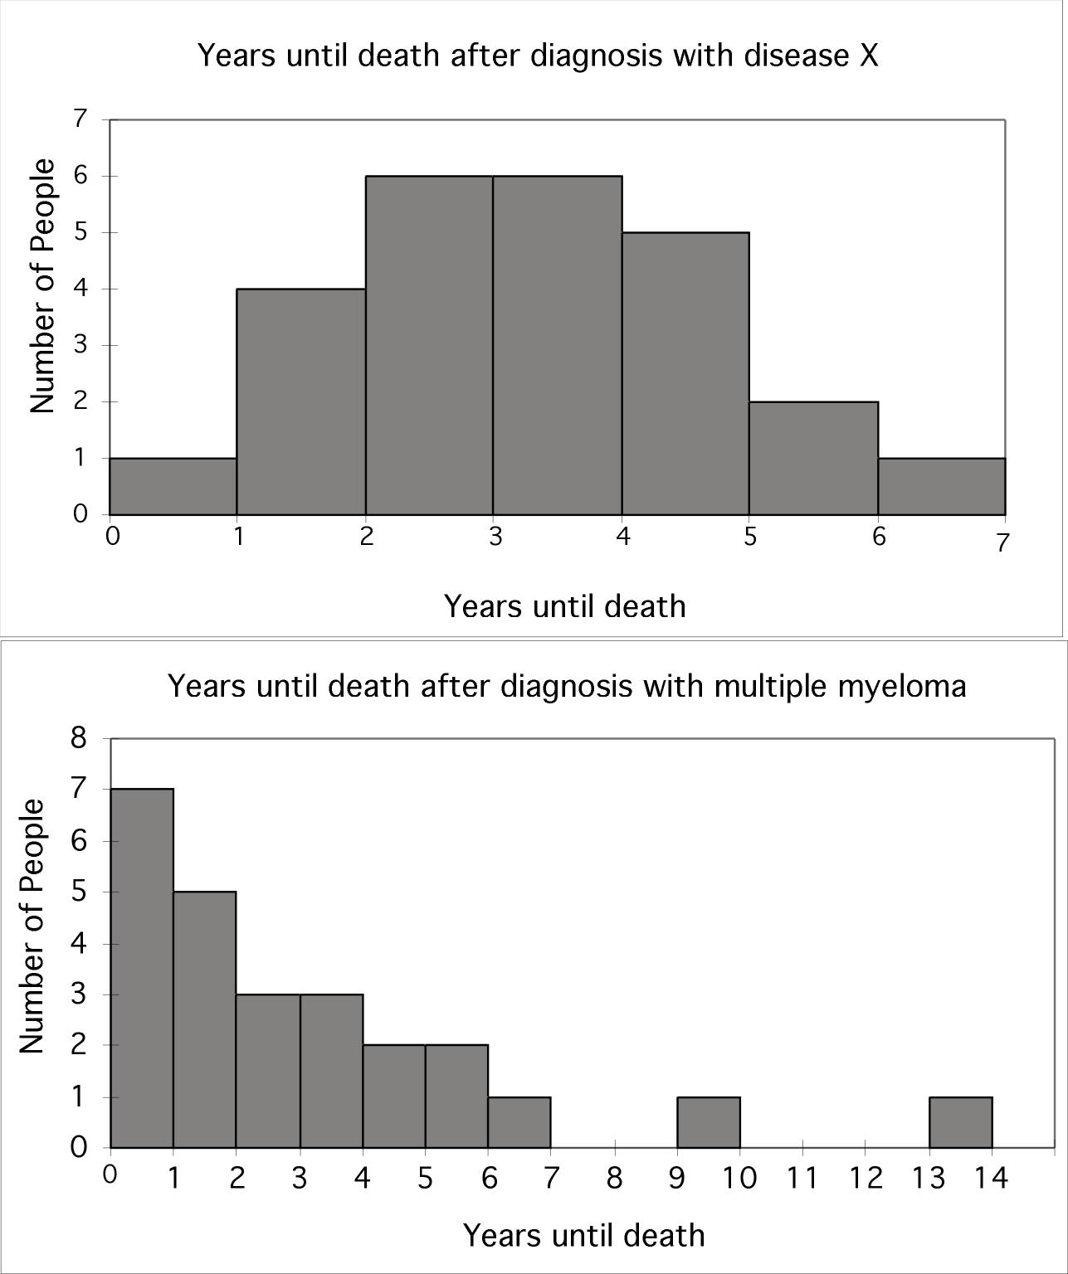
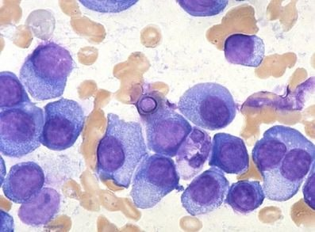
Impact of skewed data
Mean and median of a symmetric
Disease X:
Mean and median are the same.
… and a right-skewed distribution
Multiple myeloma:
The mean is pulled toward the skew.

Slide 58
Mean vs. Median
Mean is not resistant to outliers or skewness
It uses the actual value of each observation and will chase extreme values
Median is very resistant to outliers and skewness
It only works with what’s in the middle, not what’s on the edges
Mean and Median measure center in different ways
Both are useful
Good to report both and let the reader decide

Slide 59
Mean or Median?
$$$
A realtor selling homes calculates two measures of center for the price of a home in her area. She gets $127,312 and $105,100.
One is the mean and one is the median; can you guess which is which?
There are likely to be a few very high priced homes in the area, compared to the typical home. They drive the mean upwards.
Mean = $127,312
Median = $105,100
Which measure is more attractive to buyers? To sellers?
Buyers want to see low numbers, so the median is more appealing.
Sellers want to see high numbers, so the mean is more appealing.
Which measure is most appropriate?
Show both and let the client decide.

Slide 60
What should you use, when, and why?
$$$
Arithmetic mean or median?
Middletown is considering imposing an income tax on citizens. City Hall wants a numerical summary of its citizens’ income to estimate the total tax base.
In a study of standard of living of typical families in Middletown, a sociologist makes a numerical summary of family income in that city.
Mean: Although income is likely to be right-skewed, the city government wants to know about the total tax base.
Median: The sociologist is interested in a “typical” family and wants to lessen the impact of extreme incomes.

Slide 61
Measuring spread: percentiles
To calculate a percentile:
Arrange the observations in increasing order
Count up the required percentage from the bottom of the list.
Find the number that lies at or below the percentage you need.
There is not always a value with exactly p percent below/at it.

Slide 62
Measure of spread: the quartiles
The first quartile, Q₁, is the value in the sample that has 25% of the data at or below it (⬄ it is the median of the lower half of the sorted data, excluding M).
The third quartile, Q₃, is the value in the sample that has 75% of the data at or below it (⬄ it is the median of the upper half of the sorted data, excluding M).
Q₁= first quartile = 2.2
M = median = 3.4
Q₃= third quartile = 4.35

Slide 63
Example 1.23
Here is the ordered list of the times to start a business in our sample of 24 countries:
The first quartile is the median of the first 12 observations, and the third quartile is the median of the last 12 observations. Check that Q₁ = 23 and Q₃ = 46.5.

Slide 64
Five-number summary and boxplot
Largest = max = 6.1
BOXPLOT
Q₃= third quartile
= 4.35
M = median = 3.4
Q₁= first quartile
= 2.2
Five-number summary:
min Q₁ M Q₃ max
Smallest = min = 0.6

Slide 65
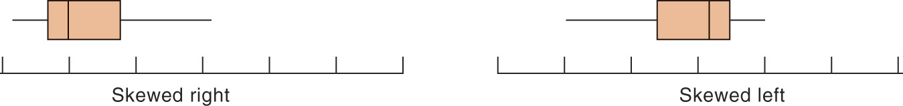
Boxplots for skewed data
Comparing boxplots for a normal and a right-skewed distribution
Boxplots remain true to the data and depict clearly symmetry or skew.

Slide 66
Suspected outliers
Outliers are troublesome data points, and it is important to be able to identify them.
One way to raise the flag for a suspected outlier is to compare the distance from the suspicious data point to the nearest quartile (Q₁ or Q₃). We then compare this distance to the interquartile range (distance between Q₁ and Q₃).
We call an observation a suspected outlier if it falls more than 1.5 times the size of the interquartile range (IQR) above the first quartile or below the third quartile. This is called the “1.5 * IQR rule for outliers.”

Slide 67
8
Distance to Q₃
7.9 − 4.35 = 3.55
Q₃ = 4.35
Interquartile range
Q₃ – Q₁
4.35 − 2.2 = 2.15
Q₁ = 2.2
Individual #25 has a value of 7.9 years, which is 3.55 years above the third quartile. This is more than 3.225 years, 1.5 * IQR. Thus, individual #25 is a suspected outlier.

Slide 68
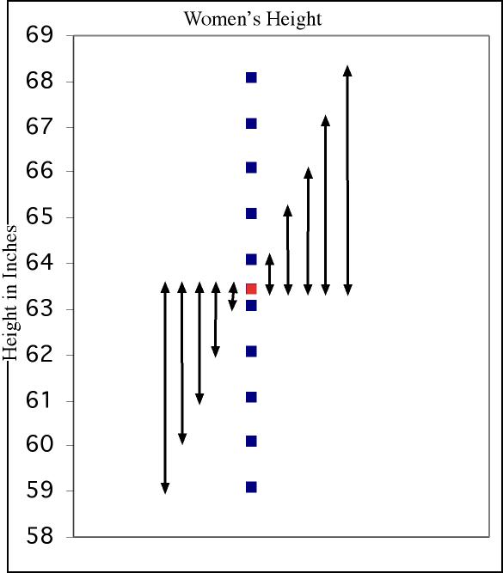
Measure of spread: the standard deviation
The standard deviation “s” is used to describe the variation around the mean. Like the mean, it is not resistant to skew or outliers.
1. First calculate the variance s².
2. Then take the square root to get the standard deviation s.
Mean
± 1 s.d.

Slide 69
Calculations …
Hourly wages
Mean = 33.33
Sum of squared deviations from mean = 2636.01
Degrees freedom (df) = (n − 1) = 8
s² = variance = 2636.01/8 = 329.5 (dollars per hour) squared
s = standard deviation = √329.5 = 2.56 dollars per hour
We’ll never calculate these by hand, so make sure to know how to get the standard deviation using your calculator.

Slide 70
Properties of Standard Deviation
s measures spread about the mean and should be used only when the mean is the measure of center.
s = 0 only when all observations have the same value and there is no spread. Otherwise, s > 0.
s is not resistant to outliers.
s has the same units of measurement as the original observations.

Slide 71
Examining Distributions The Normal Distributions
PSBE Chapter 1.3
© 2011 W.H. Freeman and Company

Slide 72
Objectives (PSBE Chapter 1.3)
Density curves and Normal distributions
Density curves
The mean and median of a density curve
Normal distributions
The 68-95-99.7 rule
The standard Normal distribution
Normal distribution calculations
Finding a value when given a proportion
Assessing the Normality of data

Slide 73
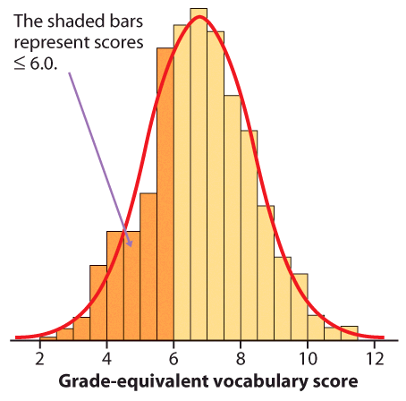
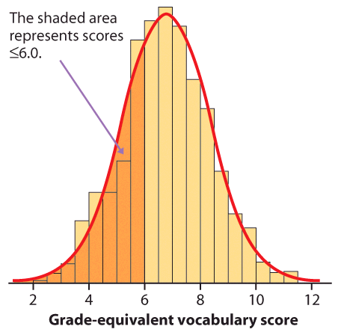
Density curves
A density curve is a mathematical model of a distribution.
The total area under the curve, by definition, is equal to 1, or 100%.
The area under the curve for a range of values is the proportion of all observations for that range.
Histogram of a sample with the smoothed density curve describing theoretically the population.

Slide 74
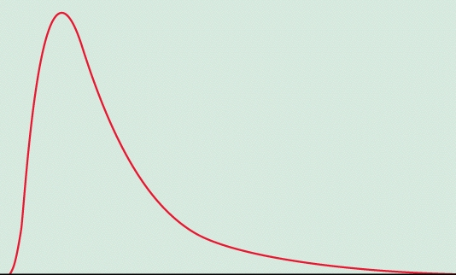
Density curves come in any imaginable shape.
Some are well known mathematically and others aren’t.

Slide 75
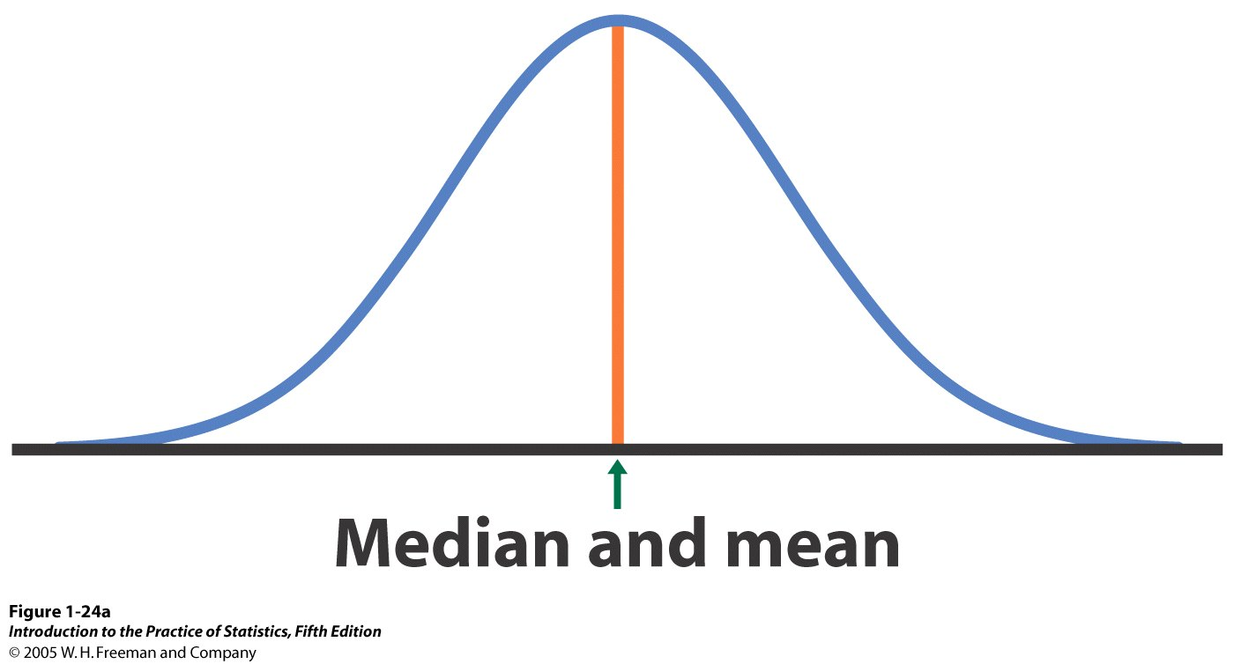
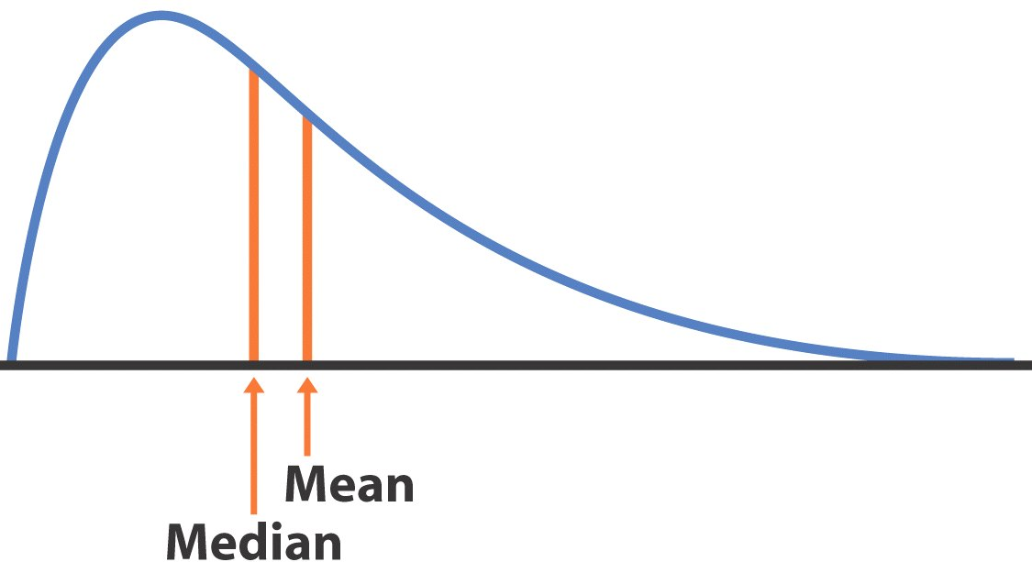
Median and mean of a density curve
The median of a density curve is the equal-areas point, the point that divides the area under the curve in half.
The mean of a density curve is the balance point, at which the curve would balance if made of solid material.
The median and mean are the same for a symmetric density curve.
The mean of a skewed curve is pulled in the direction of the long tail.

Slide 76
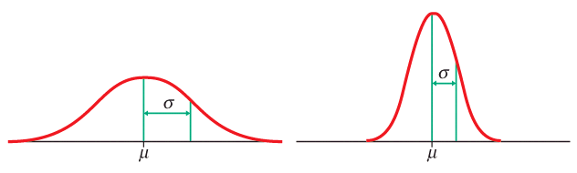
Normal distributions
Normal—or Gaussian—distributions are a family of symmetrical, bell- shaped density curves defined by a mean μ (mu) and a standard deviation σ (sigma) : N(μ,σ).
x
x
e = 2.71828… The base of the natural logarithm
π = pi = 3.14159…

Slide 77
A family of density curves
Here means are the same (μ = 15), whereas standard deviations are different (σ = 2, 4, and 6).
Here means are different (μ = 10, 15, and 20), whereas standard deviations are the same (σ = 3).

Slide 78
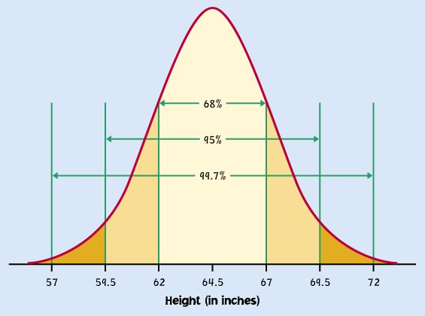
The 68-95-99.7 rule
About 68% of all observations are within 1 standard deviation (σ) of the mean (μ).
About 95% of all observations are within 2 σ of the mean μ.
Almost all (99.7%) observations are within 3 σ of the mean.
Inflection point
mean µ = 64.5 standard deviation σ = 2.5
N(µ, σ) = N(64.5, 2.5)

Slide 79
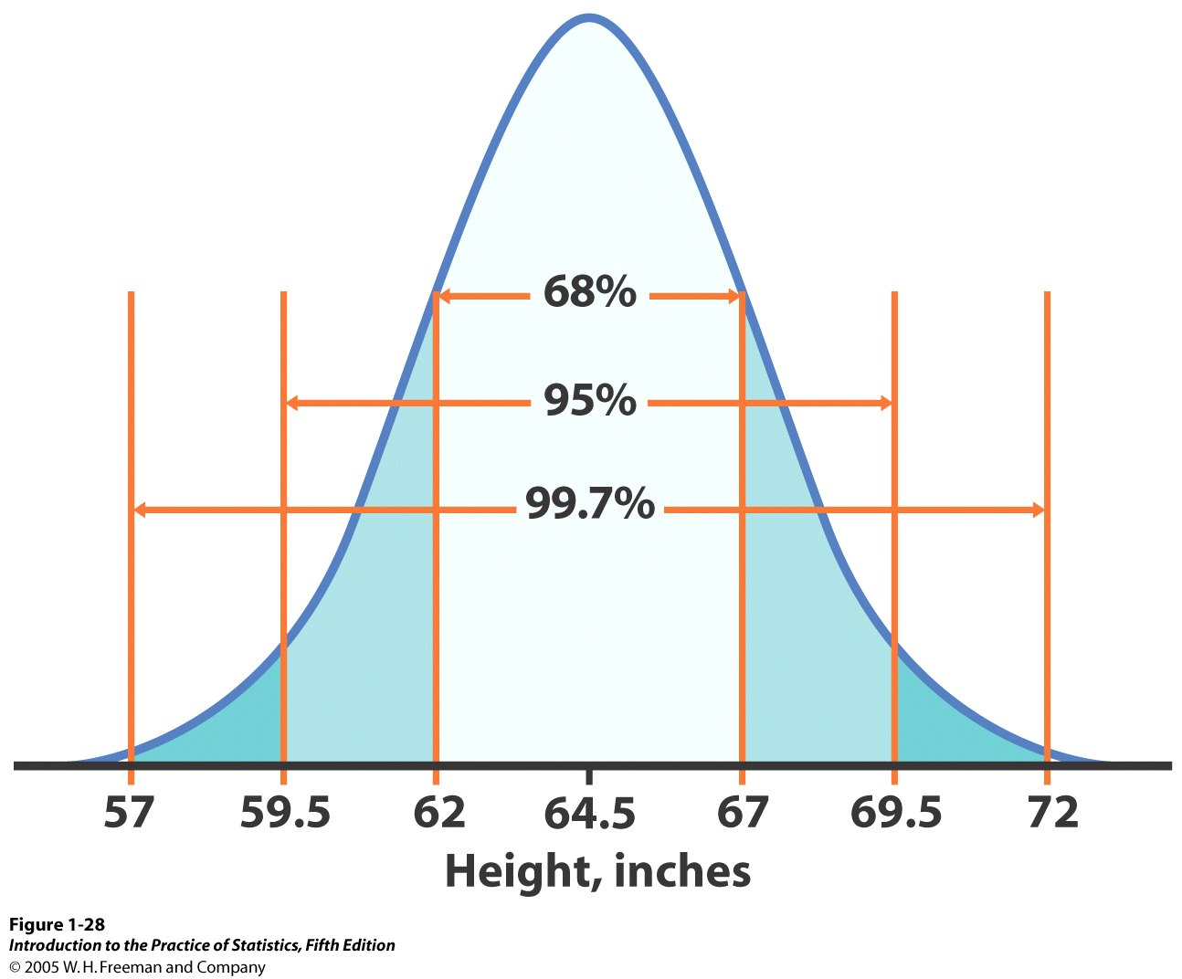
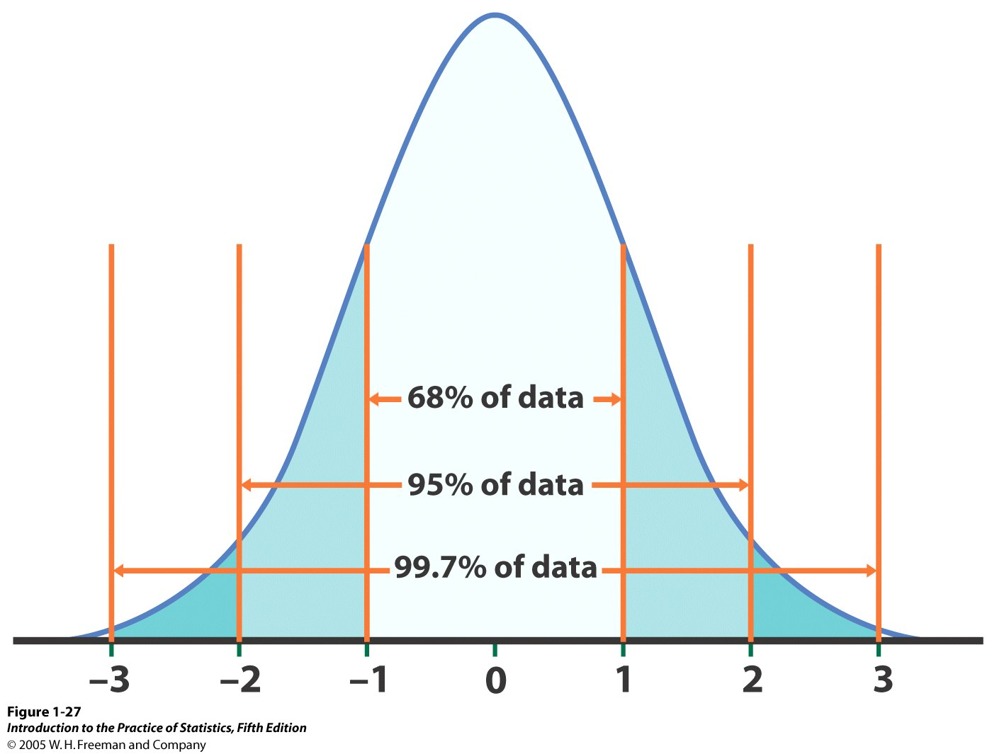
The standard Normal distribution
Because all Normal distributions share the same properties, we can standardize our data to transform any Normal curve N(μ,σ) into the standard Normal curve N(0,1).
N(64.5, 2.5)
N(0,1)
=>
Standardized height (no units)
For each x we calculate a new value, z (called a z-score).

Slide 80
Standardizing: calculating z-scores
A z-score measures the number of standard deviations that a data value x is from the mean μ.
When x is 1 standard deviation larger than the mean, then z = 1.
When x is 2 standard deviations larger than the mean, then z = 2.
When x is larger than the mean, z is positive.
When x is smaller than the mean, z is negative.

Slide 81
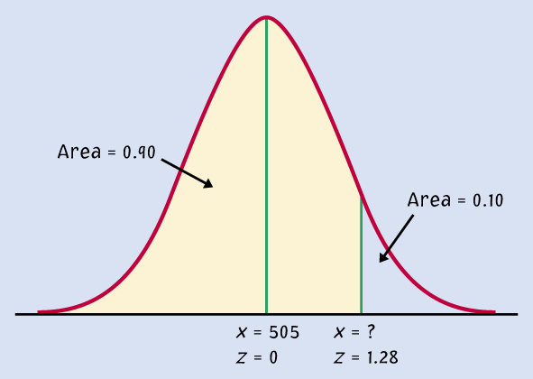
Example: Women heights
N(µ, σ) = N(64.5, 2.5)
Women heights follow the N(64.5”,2.5”) distribution. What percent of women are shorter than 67 inches tall (that’s 5’6”)?
Area= ???
Area = ???
mean µ = 64.5"
standard deviation σ = 2.5"
x (height) = 67"
μ = 64.5” x = 67”
z = 0 z = 1
We calculate z, the standardized value of x:
Because of the 68-95-99.7 rule, we can conclude that the percent of women shorter than 67” should be, approximately, 0.68 + half of (1 − 0.68) = 0.84 or 84%.

Slide 82
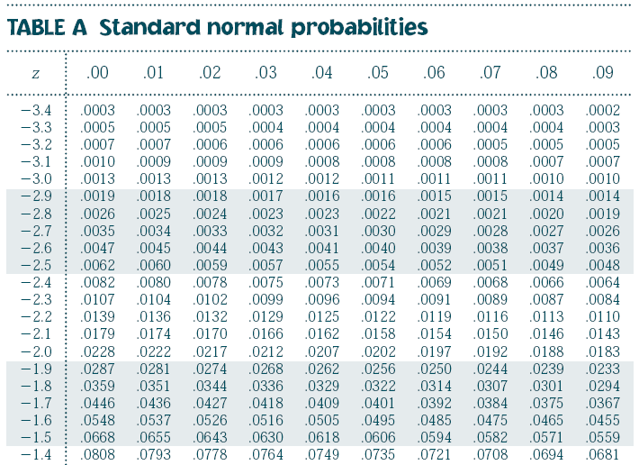
Using Table A
Table A gives the area under the standard Normal curve to the left of any z value.
0.0082 is the area under N(0,1) left of z = −2.40
0.0069 is the area under N(0,1) left of z = −2.46
0.0080 is the area under N(0,1) left of z = −2.41
(…)

Slide 83

Percent of women shorter than 67”
For z = 1.00, the area under the standard Normal curve to the left of z is 0.8413.
N(µ, σ) = N(64.5”, 2.5”)
Area ≈ 0.84
Conclusion: 84.13% of women are shorter than 67”.
By subtraction, 1 − 0.8413, or 15.87% of women are taller than 67”.
Area ≈ 0.16
μ = 64.5” x = 67”
z = 1

Slide 84



Tips on using Table A
Because the Normal distribution is symmetrical, there are two ways that you can calculate the area under the standard Normal curve to the right of a z value.
Area = 0.9901
Area = 0.0099
z = -2.33
area right of z = area left of −z
area right of z = 1 − area left of z

Slide 85

Tips on using Table A
To calculate the area between two z-values, first get the area under N(0,1) to the left for each z-value from Table A.
Then subtract the smaller area from the larger area.
A common mistake made by students is to subtract both z-values, but the Normal curve is not uniform.
area between z₁ and z₂ =
area left of z₁ – area left of z₂
➔ The area under N(0,1) for a single value of z is zero
(Try calculating the area to the left of z minus that same area!)

Slide 86
The National Collegiate Athletic Association (NCAA) requires Division I athletes to score at least 820 on the combined math and verbal SAT exam to compete in their first college year. The SAT scores of 2003 were approximately normal with mean 1026 and standard deviation 209.
What proportion of all students would be NCAA qualifiers (SAT ≥ 820)?
area right of 820 = total area - area left of 820
= 1 - 0.1611
≈ 84%
Note: The actual data may contain students who scored exactly 820 on the SAT.

Slide 87

The NCAA defines a “partial qualifier” eligible to practice and receive an athletic scholarship, but not to compete, as a combined SAT score of at least 720.
What proportion of all students who take the SAT would be partial qualifiers? That is, what proportion have scores between 720 and 820?
area between = area left of 820 - area left of 720
720 and 820 = 0.1611 - 0.0721
≈ 9%
About 9% of all students who take the SAT have scores between 720 and 820.

Slide 88


The cool thing about working with normally distributed data is that we can manipulate it and then find answers to questions that involve comparing seemingly non-comparable distributions.
We do this by “standardizing” the data. All this involves is changing the scale so that the mean now = 0 and the standard deviation = 1. If you do this to different distributions it makes them comparable.
N(0,1)

Slide 89
Finding a value when given a proportion
Inverse normal calculations: We may also want to find the observed range of values that correspond to a given proportion under the curve.
For that, we use Table A backward:
We first find the desired area/proportion in the body of the table.
We then read the corresponding z-value from the left column and top row.
For an area to the left of 1.25 % (0.0125),
the z-value is -2.24

Slide 90

Inverse Normal Calculations
SAT Verbal test scores follow approximately the N(505, 110) distribution. How high must a student score to place in the top 10% of all students taking the SAT?
1. z = 1.28 is the standardized value with area 0.9 to its left and 0.1 to its right.
2. Unstandardize
Solving for x gives a score of at least 646 on the SAT.

Slide 91
Assessing the Normality of data
One way to assess if a distribution is indeed approximately normal is to plot the data on a normal quantile plot.
The data points are ranked and the percentile ranks are converted to z-scores with Table A. The z-scores are then used for the x axis against which the data are plotted on the y axis of the normal quantile plot.
If the distribution is indeed normal the plot will show a straight line, indicating a good match between the data and a normal distribution.
Systematic deviations from a straight line indicate a non-normal distribution. Outliers appear as points that are far away from the overall pattern of the plot.

Slide 92

Normal quantile plot of the IQ of fifth graders. This distribution is roughly Normal.
Normal quantile plot of the time to start a business. This distribution is skewed to the right.

Slide 93


This distribution is roughly Normal except for one low outlier.
This distribution is skewed, not normal.

